Slide 1
Practical Implementation of Distributed CARMA: Communication-Optimal MM Algorithm
Author: Marko Kabic
marko.kabic@cscs.ch
Mentors: Dr. Joost VandeVondele Dr. Raffaele Solcà
April 1st, 2018

Slide 2
Motivation
Yet another MM algorithm?
Communication-optimal

Slide 3
Motivation
Yet another MM algorithm?
Specific matrix dimensions
(like square matrices)
Communication-optimal
IF
Certain memory ranges

Slide 4
Motivation
Yet another MM algorithm?
Specific matrix dimensions
(like square matrices)
Communication-optimal
IF
Certain memory ranges

Slide 5
Motivation
Yet another MM algorithm?
CARMA:
Communication Optimal: for any dimensions and memory ranges.
Specific matrix dimensions
(like square matrices)
Communication-optimal
IF
Certain memory ranges

Slide 6
Is communication really necessary?
k
n
n
1
1
2
2
m
k
1
2
3
4
3
m
3
4
4
1
4
1
3
2
2
2
3
1
3
4
4

Slide 7
Is communication really necessary?
Redundancy in data is necessary in order to parallelize MM
We need communication to make redundancy
If one matrix is split, the other one has to be communicated
split
communicated
1
4
1
3
2
2
2
Splitting m
1
3
3
4
4

Slide 8
We can split any dimension
4
3
2
1
1
2
3
4
Splitting n
1
2
3
4
1
4
1
3
2
2
2
Splitting m
1
3
3
4
4

Slide 9
We can split any dimension
4
1
3
2
2
Splitting k
1
2
3
4
1
3
4
Additional reduction step necessary
After reduction, matrix C has to be equally distributed
Every rank reduces one part
1
2
3
4
Parallelization requires a lot of additional memory!

Slide 10
If there is not enough memory - serialize
1,2,3,4
1,2,3,4
1,2,3,4
1
2
3
4
1
2
3
4
1
2
3
4
1
2
3
4
1,2,3,4
Splitting k
1,2,3,4
1,2,3,4
1,2,3,4
1,2,3,4
If not enough memory, solve subproblems sequentially using ALL processors.
1
2
3
4

Slide 11
If there is not enough memory - serialize
1,2,3,4
1,2,3,4
1,2,3,4
1
2
3
4
1
2
3
4
1
2
3
4
1
2
3
4
1,2,3,4
Splitting k
1,2,3,4
1,2,3,4
1,2,3,4
1,2,3,4
If not enough memory, solve subproblems sequentially using ALL processors.
No communication since sequential (same space reused)!
1
2
3
4
No additional space required!
Reduction on the fly

Slide 12
We can split any dimension
1,2,3,4
1
2
3
4
1
2
3
4
1
2
3
4
1
2
3
4
1,2,3,4
Splitting k
1,2,3,4
1
2
3
4
1,2,3,4
If not enough memory, solve subproblems sequentially using ALL processors.
No communication since sequential (same space reused)!
No additional space required!
Reduction on the fly

Slide 13
CARMA
Split the largest dimension
Repeat recursively
P processors
SPLIT

Slide 14
How does CARMA work?
Split the largest dimension
Repeat recursively
P/2 processors
P processors
If enough memory:
Solve the subproblems
in parallel
SPLIT
P/2 processors

Slide 15
How does CARMA work?
P processors
Split the largest dimension
Repeat recursively
P processors
If enough memory:
Solve the subproblems
in parallel
Otherwise
Solve the subproblems sequentially
SPLIT
P processors

Slide 16
Example of Execution
Check out the file example.pdf!

Slide 17
Sequential Step: Closer Look
Split the largest dimension
Repeat recursively
1..P
1..P
P processors
1..P
1..P
1..P
SPLIT
1…P
1..P
1..P
1..P
1..P
1..P

Slide 18
Sequential Step: Closer Look
Split the largest dimension
Repeat recursively
1..P
P processors
1..P
1..P
1..P
SPLIT
1…P
1..P
1..P
1..P
Locally:
processor 1
1..P
no communication, just moving pointers!

Slide 19
Parallel Step: Closer Look
Split the largest dimension
Repeat recursively
1..P/2
1..P/2
1..P/2
P processors
1..P/2
1..P/2
SPLIT
1…P
P/2..P
P/2..P
P/2..P
P/2..P
P/2..P

Slide 20
Parallel Step: Closer Look
Split the largest dimension
Repeat recursively
1..P/2
1..P/2
1..P/2
P processors
1, 2,…,P/2
1..P/2
1..P/2
SPLIT
1…P
P/2..P
P/2..P
P/2+1, P/2+2,…P
P/2..P
non-splitted matrix communicated
splitted matrices must NOT be communicated
non-powers of 2 more complicated
P/2..P
P/2..P
communication

Slide 21

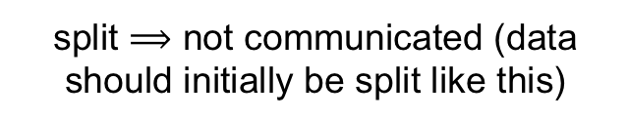
Data Layout
split $⟹$ not communicated (data should initially be split like this)
k
1. Parallel (m/2)
1..P/2
1..P/2
1..P/2
1…P
m
P/2..P
P/2..P
P/2..P
not split $⟹$ communicated

Slide 22
Data Layout
split $⟹$ not communicated (data should initially be split like this)
k
Parallel (m/2)
Parallel (n/2)
1..P/2
1..P/2
1..P/2
1…P
m
P/2..P
P/2..P
P/2..P
not split $⟹$ communicated

Slide 23
Data Layout
split $⟹$ not communicated (data should initially be split like this)
k
Parallel (m/2)
Parallel (n/2)
Sequential(k/2)
1..P/2
1..P/2
1..P/2
1..P/2
1…P
m
P/2..P
P/2..P
P/2..P
P/2..P
not split $⟹$ communicated

Slide 24
Data Layout
split $⟹$ not communicated (data should initially be split like this)
k
Parallel (m/2)
Parallel (n/2)
Sequential(k/2)
4. Base case: any load-balanced layout
1..P/2
1..P/2
1..P/2
1..P/2
1…P
m
P/2..P
P/2..P
P/2..P
P/2..P
not split $⟹$ communicated

Slide 25
Data Layout
split $⟹$ not communicated (data should initially be split like this)
k
Parallel (m/2)
Parallel (n/2)
Sequential(k/2)
4. Base case: any load-balanced layout
1..P/2
1..P/2
1..P/2
1..P/2
1…P
m
P/2..P
P/2..P
P/2..P
P/2..P
Problem: After each communication the data should be in row-major or column-major order.
not split $⟹$ communicated

Slide 26
Data Layout
Original implementation: cyclic layout in base case
Processor 1:
k
Processor 2:
Parallel (m/2)
Parallel (n/2)
Sequential(k/2)
4. Base case: any load-balanced layout
1..P/2
1..P/2
m
P/2..P
P/2..P
Problem: After each communication the data should be in row-major or column-major order.
After each communication => reshuffle

Slide 27
Data Layout
Original implementation: cyclic layout in base case
Processor 1:
Free to choose the layout in the base case
Processor 2:
BUT!
After all the communication is performed
all the matrices must be row/column-major
Is there a different base-case layout that requires less data reshuffling?
Problem: After each communication the data should be in row-major or column-major order.
After each communication => reshuffle

Slide 28
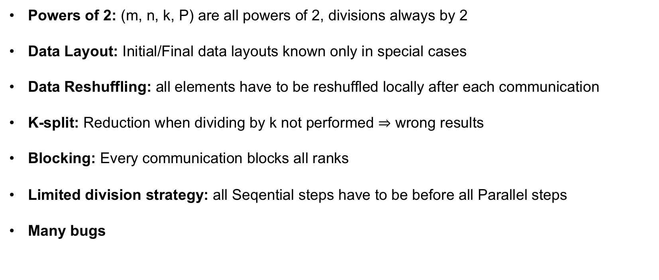
CARMA before
Powers of 2: (m, n, k, P) are all powers of 2, divisions always by 2
Data Layout: Initial/Final data layouts known only in special cases
Data Reshuffling: all elements have to be reshuffled locally after each communication
K-split: Reduction when dividing by k not performed $⇒$ wrong results
Blocking: Every communication blocks all ranks
Limited division strategy: all Seqential steps have to be before all Parallel steps
Many bugs

Slide 29
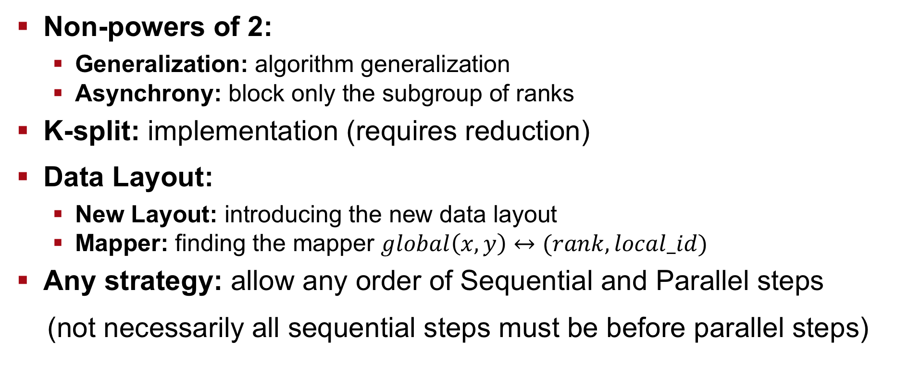
Main Improvements
Non-powers of 2:
Generalization: algorithm generalization
Asynchrony: block only the subgroup of ranks
K-split: implementation (requires reduction)
Data Layout:
New Layout: introducing the new data layout
Mapper: finding the mapper $global\left(x, y\right)↔(rank, local_id)$
Any strategy: allow any order of Sequential and Parallel steps
(not necessarily all sequential steps must be before parallel steps)

Slide 30
Main Improvements
Non-powers of 2:
Generalization: algorithm generalization
Asynchrony: block only the subgroup of ranks
K-split: implementation (requires reduction)
Data Layout:
New Layout: introducing the new data layout
Mapper: finding the mapper $global\left(x, y\right)↔(rank, local_id)$
Any strategy: allow any order of Sequential and Parallel steps
(not necessarily all sequential steps must be before parallel steps)

Slide 31
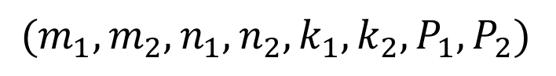
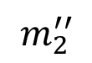
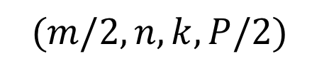
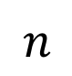
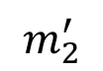
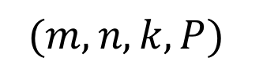
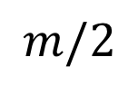
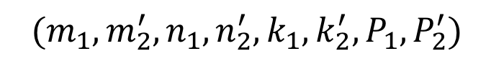
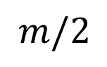
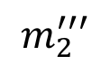
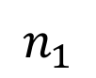
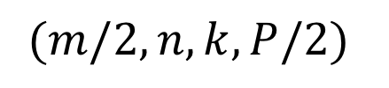
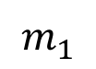
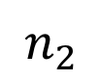
Generalizing for non-powers of 2
Before
Now
$$(m,n,k,P)$$
$$(m_{1},m_{2},n_{1}, n_{2},k_{1},k_{2},P_{1},P_{2})$$
…
…
$$(m/2,n,k,P/2)$$
$$(m/2,n,k,P/2)$$
$$(m_{1},m_{2}^{′},n_{1}, n_{2}^{′},k_{1},k_{2}^{′},P_{1},P_{2}^{′})$$
$$n$$
$$n_{1}$$
$$n_{2}$$
$$m_{1}$$
$$m/2$$
symmetric:
no need to differentiate between the subproblems
$$m_{2}^{′}$$
non-symmetric:
exact intervals (rather than just lengths) break the symmetry
$$m_{2}^{′′}$$
$$m/2$$
$$m_{2}^{′′′}$$
…
31

Slide 32
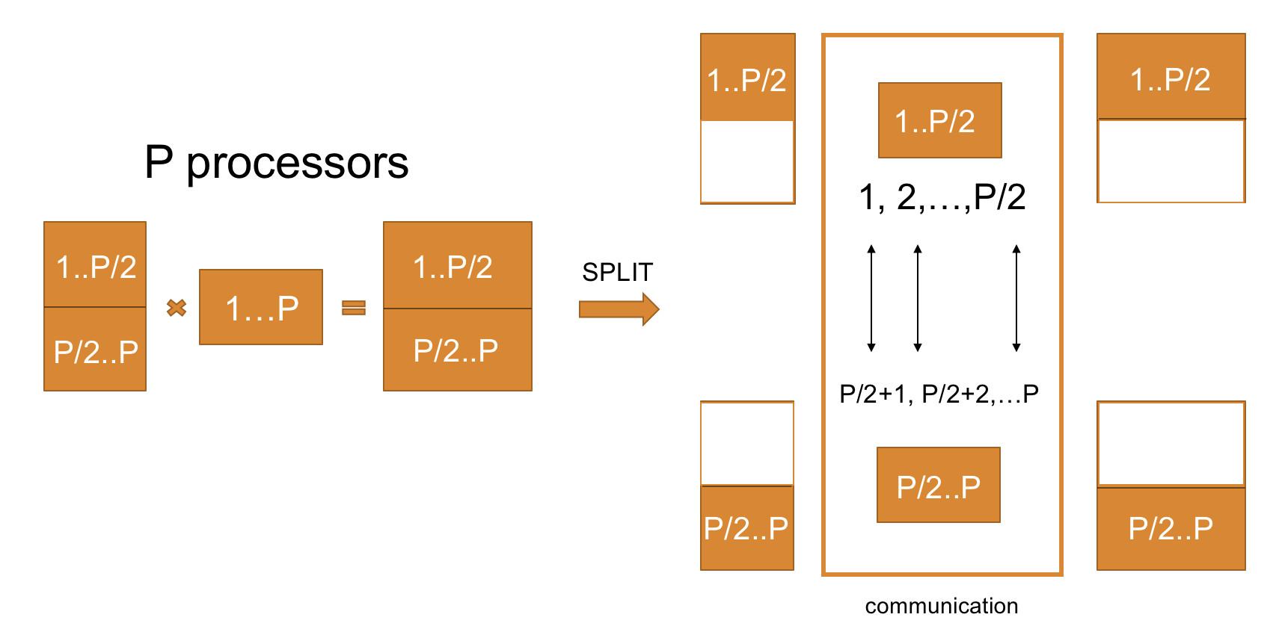
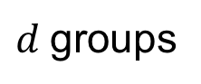

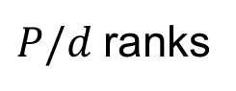
Generalizing for non-powers of 2
Before
Now
…
…
$d$groups
…
$P/d$ranks
division always by 2
ranks communicate
in groups of 2
division by $d$
32

Slide 33
Generalizing for non-powers of 2
Now
…
communication groups
…
$d$groups
…
$P/d$ranks
33

Slide 34
Generalizing for non-powers of 2
Now
…
communication groups
…
$d$groups
…
$P/d$ranks
34

Slide 35
Generalizing for non-powers of 2
Now
…
communication groups
…
$d$groups
…
$P/d$ranks
35

Slide 36
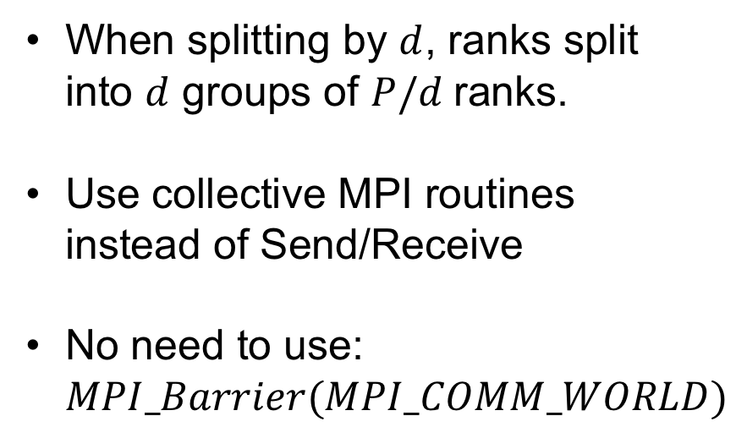
Generalizing for non-powers of 2
When splitting by $d$, ranks split into $d$ groups of $P/d$ranks.
Use collective MPI routines instead of Send/Receive
No need to use: $MPI_Barrier(MPI_COMM_WORLD)$
Now
…
communication groups
…
$d$groups
…
blocking collective MPI routines will block only the necessary ranks
$P/d$ranks
more asynchronous
36

Slide 37
Main Improvements
Non-powers of 2:
Generalization: algorithm generalization
Asynchrony: block only the subgroup of ranks
K-split: implementation (requires reduction)
Data Layout:
New Layout: introducing the new data layout
Mapper: finding the mapper $global\left(x, y\right)↔(rank, local_id)$
Any strategy: allow any order of Sequential and Parallel steps
(not necessarily all sequential steps must be before parallel steps)

Slide 38
Implementing k-split
No reduction in the original implementation => wrong results
1,2,3,4
1
2
3
4
1
2
3
4
1
2
3
4
1
2
3
4
1,2,3,4
Splitting k
1,2,3,4
1
2
3
4
1,2,3,4
At the base case, CARMA invokes dgemm.
Propagate the beta parameter through the recursion to dgemm to perform the reduction on the fly when sequentialy splitting k
No communication since sequential (same space reused)!

Slide 39
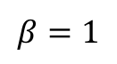
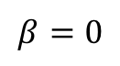
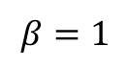
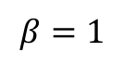
Implementing k-split
No reduction in the original implementation => wrong results
1,2,3,4
1
2
3
4
1
2
3
4
1
2
3
4
1
2
3
4
1,2,3,4
Splitting k
1,2,3,4
$$β=0$$
1
2
3
4
$$β=1$$
1,2,3,4
$$β=1$$
At the base case, CARMA invokes dgemm.
IDEA: Propagate the beta parameter through the recursion to dgemm to perform the reduction on the fly when sequentialy splitting k
$$β=1$$
No communication since sequential (same space reused)!

Slide 40












Propagating $β$-parameter
Sequential step
Parallel step
$$β=0$$
$$β=0$$
$$β=1$$
$$β=1$$
$$β=0$$
$$β=0$$
$$β=1$$
$$β=0$$
$$β=1$$
$$β=0$$
$$β=1$$
$$β=0$$

Slide 41
Propagating $β$-parameter
Sequential step
Parallel step
$$β=0$$
$$β=0$$
$$β=1$$
$$β=1$$
$$β=0$$
$$β=0$$
$$β=1$$
$$β=0$$
$$β=1$$
$$β=0$$
reduce
$$β=1$$
$$β=0$$
reduce

Slide 42
Propagating $β$-parameter
Sequential step
Parallel step
$$β=0$$
$$β=0$$
overwrite
$$β=1$$
$$β=1$$
$$β=0$$
$$β=0$$
$$β=1$$
$$β=0$$
$$β=1$$
don’t overwrite
$$β=0$$
reduce
$$β=1$$
$$β=0$$
reduce

Slide 43
Main Improvements
Non-powers of 2:
Generalization: algorithm generalization
Asynchrony: block only the subgroup of ranks
K-split: implementation (requires reduction)
Data Layout:
New Layout: introducing the new data layout
Mapper: finding the mapper $global\left(x, y\right)↔(rank, local_id)$
Any strategy: allow any order of Sequential and Parallel steps
(not necessarily all sequential steps must be before parallel steps)

Slide 44
Changing the underlying data layout
Data Layout depends on the divisions that we want to perform
IDEA: take advantage of knowing the communication groups at each step to get the underlying layout which requires no reshuffling.
Permutation of processors depends on the order of performed communication
1..Pi
split in blocks
…
assign to processors
…
1
6
4

Slide 45
Changing the underlying data layout
Data Layout depends on the divisions that we want to perform
IDEA: take advantage of knowing the communication groups at each step to get the underlying layout which requires no reshuffling.
Permutation of processors depends on the order of performed communication
Processors which communicate first => adjacent in the permutation.
Apply the previous condition recursively for each communication step
6
4
…
1
No need for reshuffling.

Slide 46
Changing the underlying data layout
Problem: communication groups known only before recursion and blocks after (not possible to separate these two tasks).
Forward propagation:
Feel up stacks with blocks that each rank is dealing with
Solution: Stack
…
Backward propagation:
Share the existing blocks among all the ranks in the same communication group
Rank 1
Rank 2
Rank 3
Rank k
communication group

Slide 47
Changing the underlying data layout
A
B
C
Example: (m, n, k, P) = (8, 8, 8, 8)
Steps: Parallel(m/2, n/2, k/2)
0 0 2 2 1 1 3 3
0 0 2 2 1 1 3 3
0 0 2 2 1 1 3 3
0 0 2 2 1 1 3 3
4 4 6 6 5 5 7 7
4 4 6 6 5 5 7 7
4 4 6 6 5 5 7 7
4 4 6 6 5 5 7 7
0 0 4 4 2 2 6 6
0 0 4 4 2 2 6 6
0 0 4 4 2 2 6 6
0 0 4 4 2 2 6 6
1 1 5 5 3 3 7 7
1 1 5 5 3 3 7 7
1 1 5 5 3 3 7 7
1 1 5 5 3 3 7 7
0 0 1 1 2 2 3 3
0 0 1 1 2 2 3 3
0 0 1 1 2 2 3 3
0 0 1 1 2 2 3 3
4 4 5 5 6 6 7 7
4 4 5 5 6 6 7 7
4 4 5 5 6 6 7 7
4 4 5 5 6 6 7 7

Slide 48
Changing the underlying data layout
A
B
C
Example: (m, n, k, P) = (8, 8, 8, 8)
Steps: Parallel(m/2, n/2, k/2)
0 0 2 2 1 1 3 3
0 0 2 2 1 1 3 3
0 0 2 2 1 1 3 3
0 0 2 2 1 1 3 3
4 4 6 6 5 5 7 7
4 4 6 6 5 5 7 7
4 4 6 6 5 5 7 7
4 4 6 6 5 5 7 7
0 0 4 4 2 2 6 6
0 0 4 4 2 2 6 6
0 0 4 4 2 2 6 6
0 0 4 4 2 2 6 6
1 1 5 5 3 3 7 7
1 1 5 5 3 3 7 7
1 1 5 5 3 3 7 7
1 1 5 5 3 3 7 7
0 0 1 1 2 2 3 3
0 0 1 1 2 2 3 3
0 0 1 1 2 2 3 3
0 0 1 1 2 2 3 3
4 4 5 5 6 6 7 7
4 4 5 5 6 6 7 7
4 4 5 5 6 6 7 7
4 4 5 5 6 6 7 7
1. Step: Parallel (m/2)
Communication (B):
0 – 4
1 – 5
2 – 6
3 – 7
0 0 2 2 1 1 3 3
0 0 2 2 1 1 3 3
0 0 2 2 1 1 3 3
0 0 2 2 1 1 3 3
0 0 0 0 2 2 2 2
0 0 0 0 2 2 2 2
0 0 0 0 2 2 2 2
0 0 0 0 2 2 2 2
1 1 1 1 3 3 3 3
1 1 1 1 3 3 3 3
1 1 1 1 3 3 3 3
1 1 1 1 3 3 3 3
0 0 1 1 2 2 3 3
0 0 1 1 2 2 3 3
0 0 1 1 2 2 3 3
0 0 1 1 2 2 3 3

Slide 49
Changing the underlying data layout
A
B
C
Example: (m, n, k, P) = (8, 8, 8, 8)
Steps: Parallel(m/2, n/2, k/2)
0 0 0 0 1 1 1 1
0 0 0 0 1 1 1 1
0 0 0 0 1 1 1 1
0 0 0 0 1 1 1 1
0 0 0 0 2 2 2 2
0 0 0 0 2 2 2 2
0 0 0 0 2 2 2 2
0 0 0 0 2 2 2 2
1 1 1 1 3 3 3 3
1 1 1 1 3 3 3 3
1 1 1 1 3 3 3 3
1 1 1 1 3 3 3 3
0 0 1 1 2 2 3 3
0 0 1 1 2 2 3 3
0 0 1 1 2 2 3 3
0 0 1 1 2 2 3 3
2. Step: Parallel (n/2)
Communication (A):
0 – 2
1 – 3
0 0 0 0 1 1 1 1
0 0 0 0 1 1 1 1
0 0 0 0 1 1 1 1
0 0 0 0 1 1 1 1
0 0 0 0
0 0 0 0
0 0 0 0
0 0 0 0
1 1 1 1
1 1 1 1
1 1 1 1
1 1 1 1
0 0 1 1
0 0 1 1
0 0 1 1
0 0 1 1

Slide 50
Changing the underlying data layout
A
B
C
Example: (m, n, k, P) = (8, 8, 8, 8)
Steps: Parallel(m/2, n/2, k/2)
0 0 0 0 1 1 1 1
0 0 0 0 1 1 1 1
0 0 0 0 1 1 1 1
0 0 0 0 1 1 1 1
0 0 0 0
0 0 0 0
0 0 0 0
0 0 0 0
1 1 1 1
1 1 1 1
1 1 1 1
1 1 1 1
0 0 1 1
0 0 1 1
0 0 1 1
0 0 1 1
3. Step: Parallel (k/2)
Communication (C):
with reduction
0 – 1
1 1 1 1
1 1 1 1
1 1 1 1
1 1 1 1
0 0 0 0
0 0 0 0
0 0 0 0
0 0 0 0
0 0 0 0
0 0 0 0
0 0 0 0
0 0 0 0
0 0 0 0
0 0 0 0
0 0 0 0
0 0 0 0
0 0 1 1
0 0 1 1
0 0 1 1
0 0 1 1
reduction

Slide 51
Reshuffling still necessary sometimes
A
B
C
Example: (m, n, k, P) = (8, 8, 8, 8)
Steps: Parallel(m/2, n/2, k/2)
0 0 2 2 1 1 3 3
0 0 2 2 1 1 3 3
0 0 2 2 1 1 3 3
0 0 2 2 1 1 3 3
4 4 6 6 5 5 7 7
4 4 6 6 5 5 7 7
4 4 6 6 5 5 7 7
4 4 6 6 5 5 7 7
0 0 4 4 2 2 6 6
0 0 4 4 2 2 6 6
0 0 4 4 2 2 6 6
0 0 4 4 2 2 6 6
1 1 5 5 3 3 7 7
1 1 5 5 3 3 7 7
1 1 5 5 3 3 7 7
1 1 5 5 3 3 7 7
0 0 1 1 2 2 3 3
0 0 1 1 2 2 3 3
0 0 1 1 2 2 3 3
0 0 1 1 2 2 3 3
4 4 5 5 6 6 7 7
4 4 5 5 6 6 7 7
4 4 5 5 6 6 7 7
4 4 5 5 6 6 7 7
Example: (m, n, k, P) = (8, 8, 8, 4)
Steps: Par(m/2), Seq(n/2), Par(k/2)
0 0 0 0 1 1 1 1
0 0 0 0 1 1 1 1
0 0 0 0 1 1 1 1
0 0 0 0 1 1 1 1
2 2 2 2 3 3 3 3
2 2 2 2 3 3 3 3
2 2 2 2 3 3 3 3
2 2 2 2 3 3 3 3
0 0 2 2 0 0 2 2
0 0 2 2 0 0 2 2
0 0 2 2 0 0 2 2
0 0 2 2 0 0 2 2
1 1 3 3 1 1 3 3
1 1 3 3 1 1 3 3
1 1 3 3 1 1 3 3
1 1 3 3 1 1 3 3
0 0 1 1 0 0 1 1
0 0 1 1 0 0 1 1
0 0 1 1 0 0 1 1
0 0 1 1 0 0 1 1
2 2 3 3 2 2 3 3
2 2 3 3 2 2 3 3
2 2 3 3 2 2 3 3
2 2 3 3 2 2 3 3
In Sequential steps, same processor can end up in both halves of the matrices.
Reshuffling of blocks necessary

Slide 52
Reshuffling still necessary sometimes
Happens only when Sequential step is nested within Parallel step of the same matrix
Reshuffling of blocks still better than reshuffling of single elements
0: B1, B3
comm.
0: B1, B2, B3, B4
2: B1, B2, B3, B4
2: B2, B4
B1
B2
B3
B4
Example: (m, n, k, P) = (8, 8, 8, 4)
Steps: Par(m/2), Seq(n/2), Par(k/2)
0 0 0 0 1 1 1 1
0 0 0 0 1 1 1 1
0 0 0 0 1 1 1 1
0 0 0 0 1 1 1 1
2 2 2 2 3 3 3 3
2 2 2 2 3 3 3 3
2 2 2 2 3 3 3 3
2 2 2 2 3 3 3 3
0 0 2 2 0 0 2 2
0 0 2 2 0 0 2 2
0 0 2 2 0 0 2 2
0 0 2 2 0 0 2 2
1 1 3 3 1 1 3 3
1 1 3 3 1 1 3 3
1 1 3 3 1 1 3 3
1 1 3 3 1 1 3 3
0 0 1 1 0 0 1 1
0 0 1 1 0 0 1 1
0 0 1 1 0 0 1 1
0 0 1 1 0 0 1 1
2 2 3 3 2 2 3 3
2 2 3 3 2 2 3 3
2 2 3 3 2 2 3 3
2 2 3 3 2 2 3 3
In Sequential steps, same processor can end up in both halves of the matrices.
Reshuffling of blocks necessary

Slide 53
Main Improvements
Non-powers of 2:
Generalization: algorithm generalization
Asynchrony: block only the subgroup of ranks
K-split: implementation (requires reduction)
Data Layout:
New Layout: introducing the new data layout
Mapper: finding the mapper $global\left(x, y\right)↔(rank, local_id)$
Any strategy: allow any order of Sequential and Parallel steps
(not necessarily all sequential steps must be before parallel steps)

Slide 54
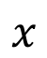
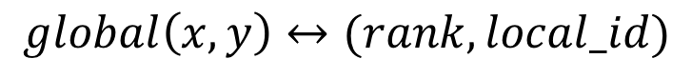
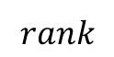
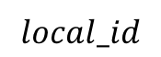
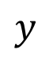
Mapper
$$global\left(x, y\right)↔(rank, local_id)$$
$$y$$
$$rank$$
$$x$$
mapper
$$local_id$$

Slide 55



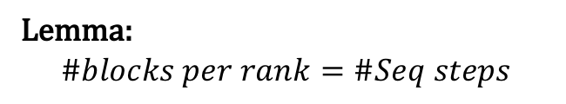
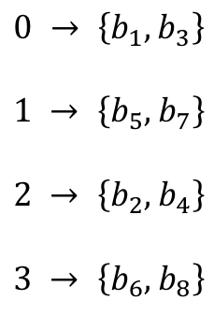

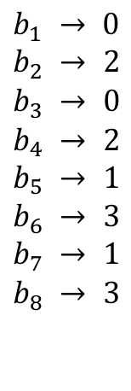





Mapper
0 0 2 2 0 0 2 2
0 0 2 2 0 0 2 2
0 0 2 2 0 0 2 2
0 0 2 2 0 0 2 2
1 1 3 3 1 1 3 3
1 1 3 3 1 1 3 3
1 1 3 3 1 1 3 3
1 1 3 3 1 1 3 3
rank
blocks
block
rank
$$b_{1}$$
$$b_{2}$$
$$b_{3}$$
$$b_{4}$$
$$0 → \left\{b_{1}, b_{3}\right\}$$
$$1 → \left\{b_{5},b_{7}\right\}$$
$$2 → \left\{b_{2},b_{4}\right\}$$
$$3 → \left\{b_{6},b_{8}\right\}$$
$$b_{1} → 0 \\ b_{2} → 2$$
$$b_{3} → 0 \\ b_{4} → 2 \\ b_{5} → 1 \\ b_{6} → 3 \\ b_{7} → 1 \\ b_{8} → 3$$
$$b_{5}$$
$$b_{6}$$
$$b_{7}$$
$$b_{8}$$
Given: $global\left(x, y\right)$, find$(rank, local_id)$
Lemma: $$\#blocks per rank=\#Seq steps$$
IDEA: use interval tree to find which block a point $\left(x, y\right)$ belongs to
Corollary :
$$no Seq steps⇒each rank owns a single block$$

Slide 56
Mapper
0 0 2 2 0 0 2 2
0 0 2 2 0 0 2 2
0 0 2 2 0 0 2 2
0 0 2 2 0 0 2 2
1 1 3 3 1 1 3 3
1 1 3 3 1 1 3 3
1 1 3 3 1 1 3 3
1 1 3 3 1 1 3 3
rank
blocks
block
rank
$$b_{1}$$
$$b_{2}$$
$$b_{3}$$
$$b_{4}$$
$$0 → \left\{b_{1}, b_{3}\right\}$$
$$1 → \left\{b_{5},b_{7}\right\}$$
$$2 → \left\{b_{2},b_{4}\right\}$$
$$3 → \left\{b_{6},b_{8}\right\}$$
$$b_{1} → 0 \\ b_{2} → 2$$
$$b_{3} → 0 \\ b_{4} → 2 \\ b_{5} → 1 \\ b_{6} → 3 \\ b_{7} → 1 \\ b_{8} → 3$$
$$b_{5}$$
$$b_{6}$$
$$b_{7}$$
$$b_{8}$$
Given: $global\left(x, y\right)$, find$(rank, local_id)$
Lemma: $$\#blocks per rank=\#Seq steps$$
IDEA: use interval tree to find which block a point $\left(x, y\right)$ belongs to
Corollary :
$$no Seq steps⇒each rank owns a single block$$

Slide 57
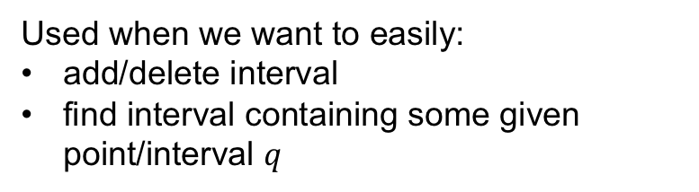

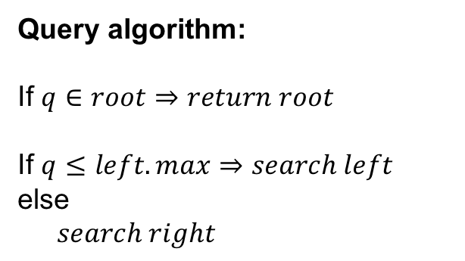
Interval Tree
Used when we want to easily:
add/delete interval
find interval containing some given point/interval $q$
Query algorithm:
If $q∈root⇒return root$
If $q≤left.max⇒search left$
else
$search right$
Self-balancing
Binary Search Tree (BST) with respect to left endpoint
Query complexity: $O(\log{\#nodes})$

Slide 58




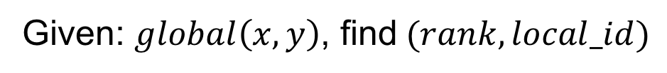
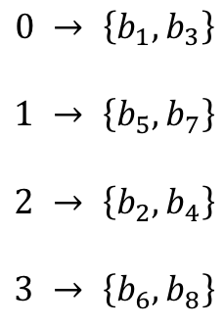

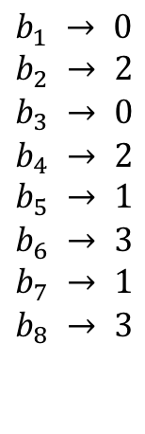

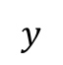



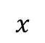
Mapper
Columns Interval Tree
$$y$$
rank
blocks
block
rank
$$b_{1}$$
$$b_{2}$$
$$b_{3}$$
$$b_{4}$$
$$0 → \left\{b_{1}, b_{3}\right\}$$
$$1 → \left\{b_{5},b_{7}\right\}$$
$$2 → \left\{b_{2},b_{4}\right\}$$
$$3 → \left\{b_{6},b_{8}\right\}$$
$$b_{1} → 0 \\ b_{2} → 2$$
$$b_{3} → 0 \\ b_{4} → 2 \\ b_{5} → 1 \\ b_{6} → 3 \\ b_{7} → 1 \\ b_{8} → 3$$
Rows Interval Tree
$$x$$
$$b_{5}$$
$$b_{6}$$
$$b_{7}$$
$$b_{8}$$
Given: $global\left(x, y\right)$, find$(rank, local_id)$
IDEA: use rows interval tree to locate a block containing $x$
and use columns interval tree to local a block containing $y$

Slide 59

Mapper
Columns Interval Tree
$$y$$
rank
blocks
block
rank
$$b_{1}$$
$$b_{2}$$
$$b_{3}$$
$$b_{4}$$
$$0 → \left\{b_{1}, b_{3}\right\}$$
$$1 → \left\{b_{5},b_{7}\right\}$$
$$2 → \left\{b_{2},b_{4}\right\}$$
$$3 → \left\{b_{6},b_{8}\right\}$$
$$b_{1} → 0 \\ b_{2} → 2$$
$$b_{3} → 0 \\ b_{4} → 2 \\ b_{5} → 1 \\ b_{6} → 3 \\ b_{7} → 1 \\ b_{8} → 3$$
Rows Interval Tree
$$x$$
$$b_{5}$$
$$b_{6}$$
$$b_{7}$$
$$b_{8}$$
Given: $global\left(x, y\right)$, find$(rank, local_id)$
$$O\left(\log{\#steps}\right) \\ =O(\log{\log{P}})$$
IDEA: use rows interval tree to locate a block containing $x$
and use columns interval tree to local a block containing $y$

Slide 60
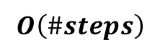
Mapper
Columns Interval Tree
$$y$$
rank
blocks
block
rank
$$b_{1}$$
$$b_{2}$$
$$b_{3}$$
$$b_{4}$$
$$0 → \left\{b_{1}, b_{3}\right\}$$
$$1 → \left\{b_{5},b_{7}\right\}$$
$$2 → \left\{b_{2},b_{4}\right\}$$
$$3 → \left\{b_{6},b_{8}\right\}$$
$$b_{1} → 0 \\ b_{2} → 2$$
$$b_{3} → 0 \\ b_{4} → 2 \\ b_{5} → 1 \\ b_{6} → 3 \\ b_{7} → 1 \\ b_{8} → 3$$
Rows Interval Tree
$$x$$
$$b_{5}$$
$$b_{6}$$
$$b_{7}$$
$$b_{8}$$
Given: $global\left(x, y\right)$, find$(rank, local_id)$
$$O\left(\log{\#steps}\right) \\ =O(\log{\log{P}})$$
Previous solution for powers of 2:
$$O\left(\#steps\right)$$

Slide 61
Mapper
Columns Interval Tree
$$y$$
rank
blocks
block
rank
$$b_{1}$$
$$b_{2}$$
$$b_{3}$$
$$b_{4}$$
$$0 → \left\{b_{1}, b_{3}\right\}$$
$$1 → \left\{b_{5},b_{7}\right\}$$
$$2 → \left\{b_{2},b_{4}\right\}$$
$$3 → \left\{b_{6},b_{8}\right\}$$
$$b_{1} → 0 \\ b_{2} → 2$$
$$b_{3} → 0 \\ b_{4} → 2 \\ b_{5} → 1 \\ b_{6} → 3 \\ b_{7} → 1 \\ b_{8} → 3$$
Rows Interval Tree
$$x$$
$$b_{5}$$
$$b_{6}$$
$$b_{7}$$
$$b_{8}$$
Given: $global\left(x, y\right)$, find$(rank, local_id)$
$$O\left(\log{\#steps}\right) \\ =O(\log{\log{P}})$$
Previous solution for powers of 2:
$$O\left(\#steps\right)$$

Slide 62
Data Layout Summary
Less data reshufflings needed, and if needed reshufflings
are on the level of blocks
More efficient and simpler mapper
Could probably be reduced to Scalapack blocked layout which is more compatible with other linear-algebra libraries.
0 0 2 2 1 1 3 3
0 0 2 2 1 1 3 3
0 0 2 2 1 1 3 3
0 0 2 2 1 1 3 3
4 4 6 6 5 5 7 7
4 4 6 6 5 5 7 7
4 4 6 6 5 5 7 7
4 4 6 6 5 5 7 7
0 0 1 1 2 2 3 3
0 0 1 1 2 2 3 3
0 0 1 1 2 2 3 3
0 0 1 1 2 2 3 3
4 4 5 5 6 6 7 7
4 4 5 5 6 6 7 7
4 4 5 5 6 6 7 7
4 4 5 5 6 6 7 7
relabel ranks

Slide 63
Main Improvements
Non-powers of 2:
Generalization: algorithm generalization
Asynchrony: block only the subgroup of ranks
K-split: implementation (requires reduction)
Data Layout:
New Layout: introducing the new data layout
Mapper: finding the mapper $global\left(x, y\right)↔(rank, local_id)$
Any strategy: allow any order of Sequential and Parallel steps
(not necessarily all sequential steps must be before parallel steps)

Slide 64
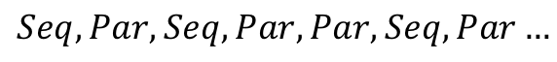
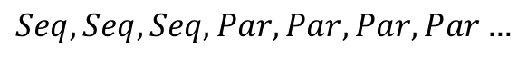
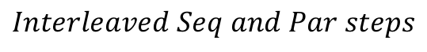
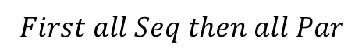
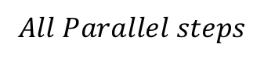
Allowing any splitting strategy
Originally, all Sequential steps had to be before all Parallel steps
$$Seq, Seq, Seq, Par, Par, Par, Par…$$
If Sequential and Parallel steps interleaved complicated splitting schemes
$$Seq, Par, Seq, Par, Par, Seq, Par…$$
We want to be able to interleave step types because:
$$Interleaved Seq and Par steps$$
$$First all Seq then all Par$$
$$All Parallel steps$$
Requires least memory
Requires most communication
tradeoff between
memory and comm
Requires most memory
Requires least communication

Slide 65
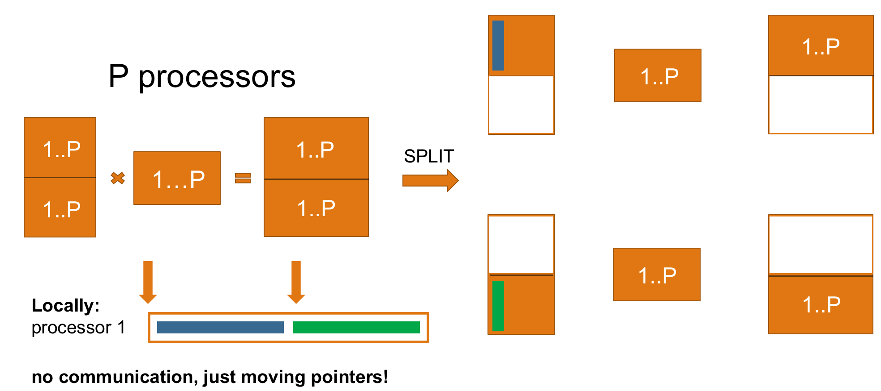
Sequential Steps Complications
Specific to the new data layout we use!
by how much in each step?
If interleaved steps allowed, two consequtive Seqential steps might consist of many nested and unequal substeps
blocks might change their sizes inside the recursive call

Slide 66
Sequential Steps Complications
by how much in each step?
If interleaved steps allowed, two consequtive Seqential steps might consist of many nested and unequal substeps
blocks might change their sizes inside the recursive call

Slide 67
Sequential Steps Complications
by how much in each step?
If interleaved steps allowed, two consequtive Seqential steps might consist of many nested and unequal substeps
blocks might change their sizes inside the recursive call

Slide 68
Sequential Steps Complications
by how much in each step?
We cannot just jump to the next block!!!

Slide 69
Sequential Steps Solution
by how much in each step?
We cannot just jump to the next block!!!

Slide 70
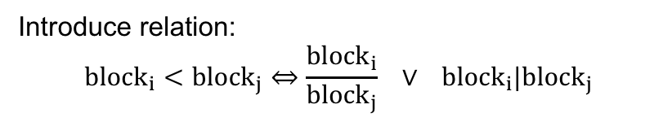
Sequential Steps Solution
by how much in each step?
Introduce relation: $${block}_{i}<{block}_{j}⇔\frac{{block}_{i}}{{block}_{j}} ∨ {block}_{i}|{block}_{j}$$
Skip all blocks less than the current submatrix

Slide 71

Parallel Steps Complications
current submatrix
rank
1
by how much in each step?
Introduce relation: ${block}_{i}∈{block}_{j}⇔$ ${block}_{i}$ inside ${block}_{j}$
P/2 +1
Copy only the blocks inside the current submatrix

Slide 72
CARMA NOW
Non-powers of 2:
Generalization: algorithm generalization
Asynchrony: block only the subgroup of ranks
K-split: implementation (requires reduction)
Data Layout:
New Layout: introducing the new data layout
Mapper: finding the mapper $global\left(x, y\right)↔(rank, local_id)$
Any strategy: allow any order of Sequential and Parallel steps
(not necessarily all sequential steps must be before parallel steps)

Slide 73
Further Research
Find optimal strategy
Default Strategy seems best
But it also depends on dgemm
Make it completely asynchronous

Slide 74
Thank you for your attention.

